Slide 1
Weekly report: Electrical Drivetrain
Week number: 5
Date: 28/10/2025
Supervisor: Prof. Dr.-Ing. Saiju
Group members: Aiswarya Vijayan, Vishranti Shivajirao Patil , Girish Mahadeo Padalkar, Cristina Milene Vergara Hernandez

Slide 2
List of contents
Complete Electrical Drivetrain Overview
Component Dimensions & Parameters
Transformer Calculation & Simulation Plan
Converter Dimensioning & Control Concept
Cables and Switchgear Findings
System Integration & Next Simulation Steps
Cristina Vergara
Electrical Drive Train/ Optimus Syria

Slide 3
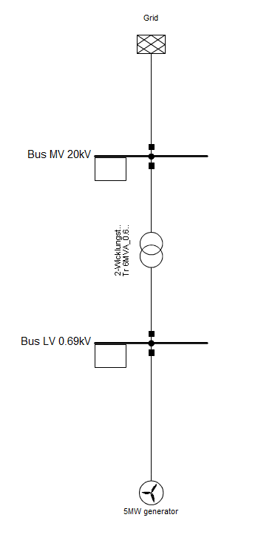
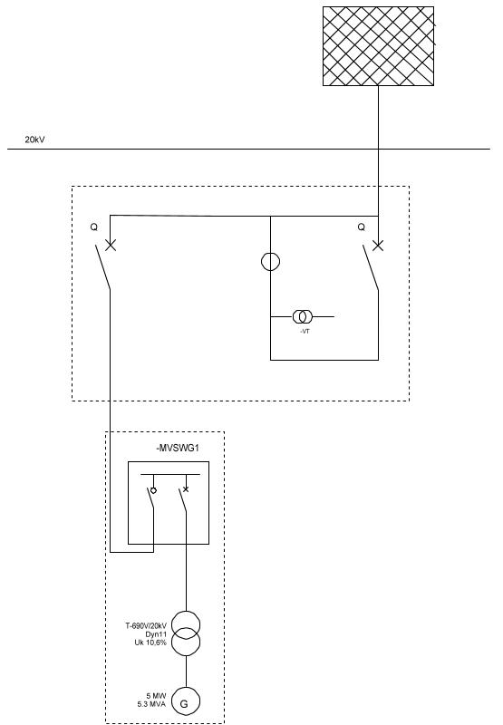
1. Complete Electrical Drivetrain Overview
SLD Power Factory
SLD sPlan8
Cristina Vergara
Electrical Drive Train/ Optimus Syria

Slide 4
2. Component Dimensions & Parameters
Component | Type / Model | Key Ratings
Generator | Doubly Fed Induction Generator (DFIG) | Rated Power: 5 MW · Voltage: 690 V · Frequency: 50 Hz · Speed: 1000 rpm (geared) · Efficiency: 96–97 %
Converter | Partial-scale back-to-back VSC (IGBT-based) | Rated Power: 1.25–1.5 MW (25–30 % of generator) · DC-Link: ≈ 1.1 kV · Efficiency: ≈ 98 %
Transformer | Oil-immersed step-up transformer | Power: 5 MVA · Voltage: 11/33 kV · Vector Group: Dyn11 · Impedance: 6–8 % · Efficiency: ≈ 99 %
Cables | XLPE-insulated MV cables (IEC 60502-2) | Voltage: 20 kV · Cross-section: 150–240 mm² (Al/Cu) · Temp: up to 105 °C
Switchgear | 20 kV GIS (e.g. Siemens 8DJH) | Short-circuit: 25 kA (1 s) · Current: 630–1250 A · Frequency: 50 Hz
Cristina Vergara
Electrical Drive Train/ Optimus Syria

Slide 5
3. Transformer Calculation & Simulation Plan
Transformer Specifications
Type: Oil-immersed step-up transformer (ONAN / ONAF cooling)
Rated Power: 5 MVA
Primary / Secondary Voltage: 11 kV / 33 kV
Frequency: 50 Hz
Vector Group: Dyn11
Efficiency: ≈ 99 % at rated load
Impedance: 6–8 %
Standards: IEC 60076 / IEEE C57
The transformer will be modeled and analyzed to validate voltage regulation, losses, and integration within the full electrical drivetrain.
Cristina Vergara
Electrical Drive Train/ Optimus Syria

Slide 6
4. Converter Dimensioning & Control Concept
Converter Dimensioning
Partial-scale back-to-back VSC using IGBT modules (e.g., Infineon FF1500R17IP5).
Power rating: ≈ 1.25–1.5 MW (25–30 % of generator).
DC-link voltage: ~1.1 kV.
Efficiency ≈ 98 %.
Protection: DC-link overvoltage, short-circuit, and ride-through control.
Cooling: air or liquid, depending on nacelle configuration.
Control Concept
Rotor-Side Converter (RSC): controls generator torque and reactive power.
Grid-Side Converter (GSC): maintains DC-link voltage and manages grid synchronization.
Control Strategy: field-oriented (vector) control with dq-reference frame; ensures fast dynamic response under weak-grid conditions.
Grid Code Compliance: supports reactive current injection and LVRT (Low Voltage Ride-Through).
Cristina Vergara
Electrical Drive Train/ Optimus Syria

Slide 7
5. Cables and Switchgear Findings
Cables
Type: 20 kV XLPE-insulated single-core underground cables (IEC 60502-2).
Conductor: Aluminium (cost-efficient) or Copper (compact, high-current).
Cross-section: 150–240 mm².
Installation: Trefoil arrangement, directly buried with earthing & lightning protection (VDE 0276).
Approx. Cost: USD 20–40/m (Al) or 60–120/m (Cu); ~500 m run ≈ USD 30k–180k.
Example Products: Prysmian NA2XS(F)2Y 12/20 kV; Nexans XKDT 1×240 Al 12/20 kV.
Terminations & Accessories: Indoor/outdoor kits, joints, bonding and earthing per IEC 60840.
Switchgear
Type: 20 kV Gas-Insulated Switchgear (GIS) (e.g., Siemens 8DJH).
Functions: Circuit breaker, isolator, CTs/VTs, relay & SCADA interface.
Short-circuit: 25 kA (1 s); Rated current: 630–1250 A.
Advantages: Compact, sealed, dust-proof; ideal for harsh Syrian climate.
Cristina Vergara
Electrical Drive Train/ Optimus Syria

Slide 8
7.Next Step
Develop the complete DFIG drivetrain model in MATLAB/Simulink.
Implement vector control for the rotor- and grid-side converters.
Simulate system behavior under weak-grid and variable wind conditions.
Evaluate power flow, voltage regulation, and efficiency.
Analyze transient response and fault-ride-through capability.
Optimize converter and transformer parameters if needed.
Prepare simulation results and graphs for the next presentation.
Cristina Vergara

Slide 9

Bibliography
[1] S. Müller, M. Deicke, and R. W. De Doncker, “Doubly Fed Induction Generator Systems for Wind Turbines,” IEEE Ind. Appl. Mag., 8(3), pp. 26–33, 2002. [2] F. Blaabjerg and K. Ma, “Wind Energy Systems,” Proc. IEEE, 105(11), pp. 2116–2131, 2017. [3] U.S. DOE, “How a Wind Turbine Works (Text Version),” 2025. [4] Hitachi Energy, “Transformers for Wind Turbine Generators,” 2023. [5] Prysmian Group, “Medium-Voltage Cable Catalogue – 20 kV XLPE Power Cables,” 2023. [6] Siemens Energy, “8DJH 36 kV Gas-Insulated Switchgear – Technical Data Sheet,” 2023. [7] Infineon, “FF1500R17IP5 IGBT Module Datasheet,” 2023. [8] IRENA, “Renewable Energy Technology Cost Database – Onshore Wind,” 2024.
10/28/2025
Cristina Vergara

